Slide 1
Quality control in supply chain using IOT and Blockchain
IOTHINC

Slide 2
The 3 Keywords in the Title-
Supply Chain
IOT
Blockchain

Slide 3
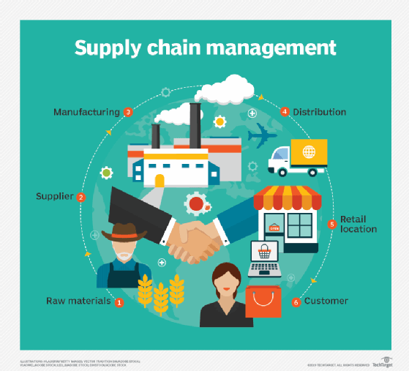
Supply Chain
A supply chain is a network between a company and its suppliers to produce and distribute a specific product to the final buyer.
In 2020, the global supply chain management market was valued at 15.85 billion U.S. dollars and is expected to reach almost 31 billion U.S. dollars by 2026.

Slide 4
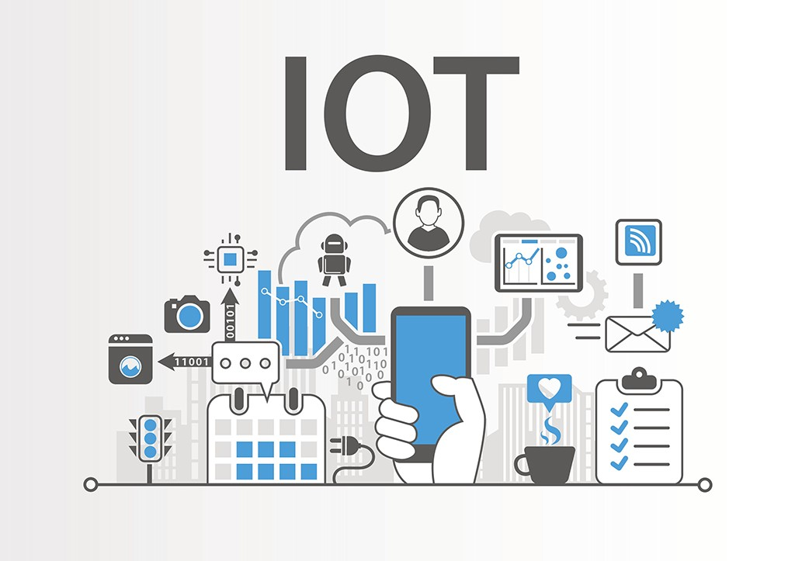
IOT
The Internet of Things (IoT) describes the network of physical objects—“things”—that are embedded with sensors, software, and other technologies for the purpose of connecting and exchanging data with other devices and systems over the internet.

Slide 5
IOT in supply chain
In the supply chain, Internet of Things devices are an effective way to track and authenticate products and shipments using GPS and other technologies. They can also monitor the storage conditions of products which enhances quality management throughout the supply chain.
IoT devices use sensors to measure specific aspects of the world around them, including location, temperature, humidity, light levels, movement, handling, speed of movement and other environmental factors. IoT devices come in many form factors including RFID chips, smart devices and mobile sensors.

Slide 6
Benefits of using Iot in Supply chain
Real time asset condition access
Optimized route planning (Like visiting workstation when needed)
Notifying the receiver or consumer prior and providing real time location information.
Efficient asset management (Like cooling ice cream, when the room temperature increases)
Provides logistics to be analysed, for further optimizations

Slide 7
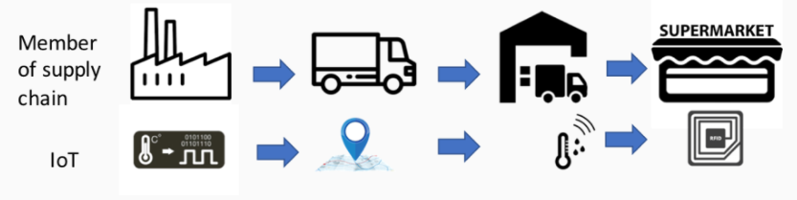
End to End real time visibility of assets.
Create a digital twin of the product or asset using iot sensor informations. Thereby monitoring shipment condition.
This allows to repair the vehicle (transport) condition that is being monitored, if any part of it is about to break down. For example, Swapping overheated Engine.

Slide 8
How Asset quality is ensured
Starting from the production to delivery of the products, It needs to be monitored and tested.
Quality of the product is tested at each phase by inspecting them thoroughly.
The results obtained are analyzed and are used to modify the production process as necessary thereby increasing the quality of the products.
The data collected by the iot sensors provide real time analysis and make it suitable to modify the process.

Slide 9
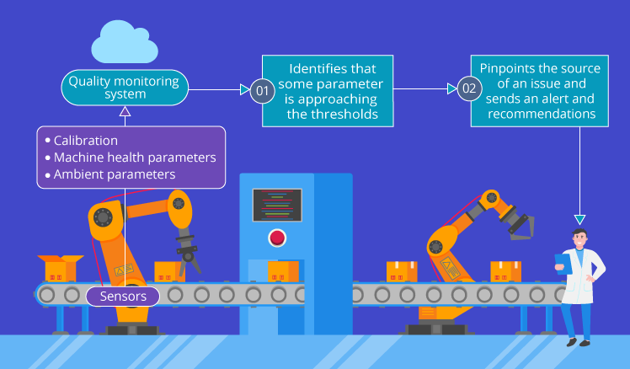

Slide 10
Blockchain
Blockchain is a distributed, immutable ledger that makes recording transactions and tracking assets in a network much easier.
It can help supply chain partners with some of their challenges by creating a complete, transparent, tamperproof history of the information flows, inventory flows, and financial flows in transactions.

Slide 11
Why use Blockchain in Supply Chain
Increased supply chain transparency and traceability
Faster and efficient delivery of products
Decentralisation of data
Improve security through encryption
Monitor and modify the states of the asset, which gets updated in blockchain and accessible to all the listeners (consumers or producers)
These saved contracts can assist in analyzing the logistics in real time

Slide 12
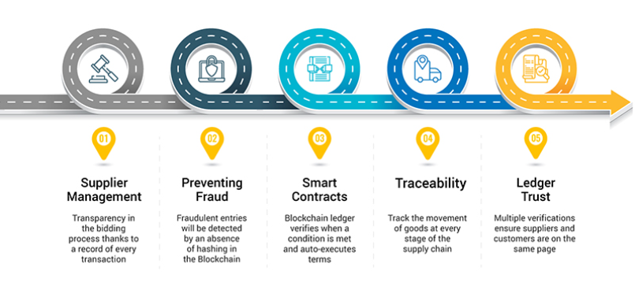

Slide 13
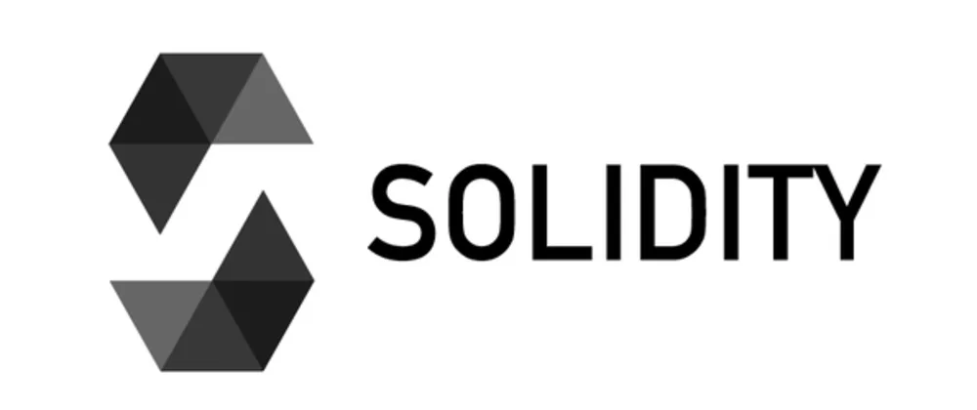
SOLIDITY → https://docs.soliditylang.org/
REMIX IDE → https://remix.ethereum.org/
METAMASK WALLET → https://metamask.io/download/

Slide 14
WorkFlow
SOLIDITY CODE COMPILE AND DEPLOY
GET ABI AND CONTRACT ADDRESS
USE ABI AND CONTRACT ADDRESS TO CREATE BACKEND(FASTAPI)
USING BACKEND WE CAN SEND AND RETRIEVE DATA FROM BLOCKCHAIN
THEN GET DATA FROM SENSORS OR ANY PLATFORMS IN NODE RED
CALL THE PYTHON API FROM NODE RED TO INTERACT WITH BLOCKCHAIN

Slide 15
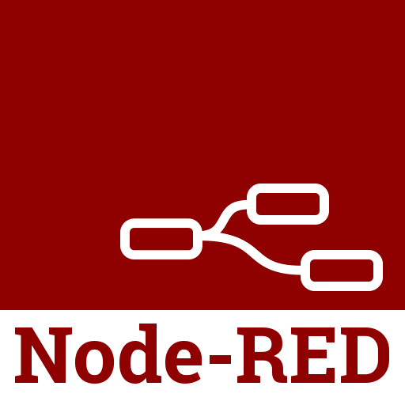
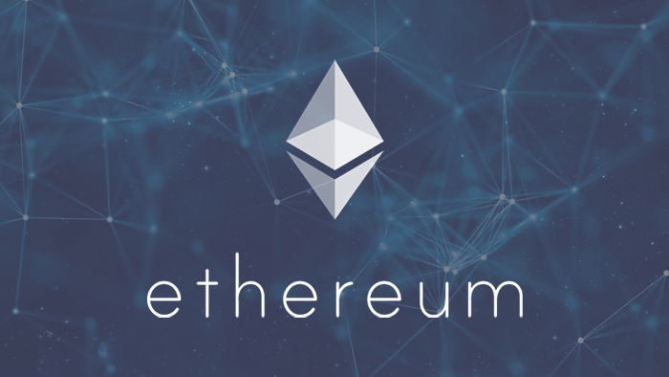
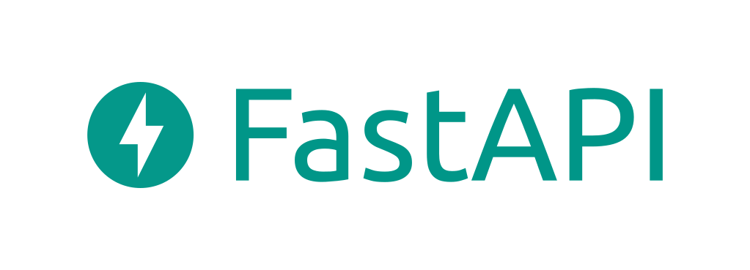
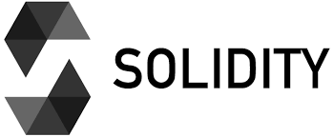
CALL API
INTERACTION
ABI AND ADDRESS

